Slide 1

Suitable Data Structure For A Contact Management Application Frequently Inserts And Deletes User Records Dynamically
CSA0313 – DATA STRUCTURE
C
Presented by :
S.Akshitha(192521390)

Slide 2
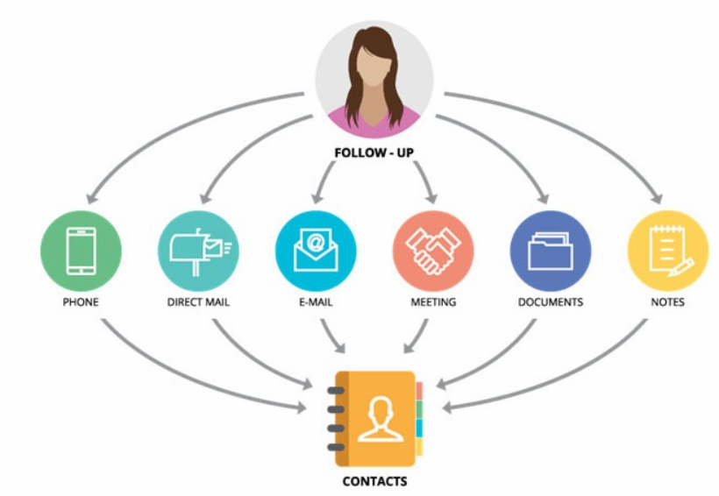
INTRODUCTION
A contact management application stores user details such as names, phone numbers, and email addresses.
It allows users to add, update, search, and delete contact records.
The number of contacts changes frequently over time.
The application requires a data structure that supports dynamic data management.
Choosing the right data structure improves performance and memory efficiency.

Slide 3
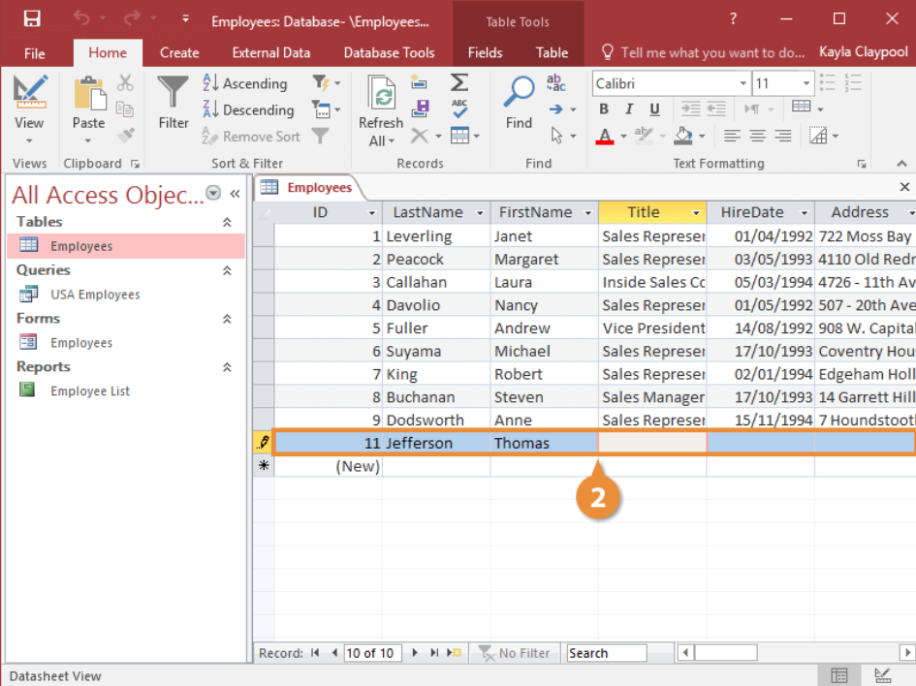
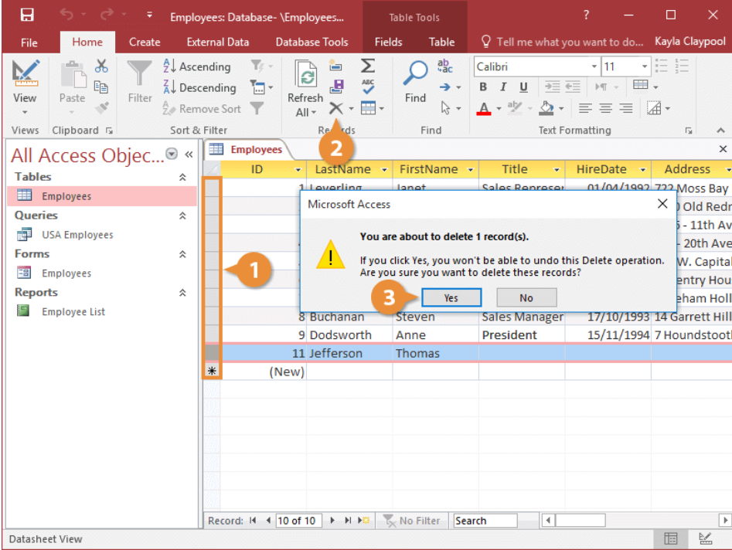
Problem Statement
Contact records are frequently inserted and deleted.
Arrays require shifting elements during insertion and deletion.
This increases execution time for large datasets.
Fixed-size storage may lead to memory wastage or overflow.
An efficient dynamic data structure is needed for better performance

Slide 4
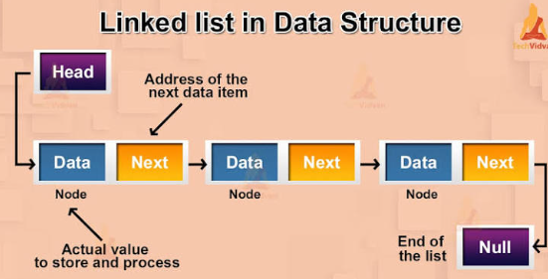
Suitable Data Structure
Use a Linked List to store contact records.
Each contact is stored as a separate node.
Nodes are connected using pointers.
Contacts can be inserted or deleted without shifting other records.
Memory is allocated dynamically based on the number of contacts.

Slide 5
Justification
Provides fast insertion and deletion operations.
Uses dynamic memory efficiently.
No fixed storage size is required.
Easy to update and manage contact records.
Suitable for applications with frequently changing data

Slide 6


